Slide 1
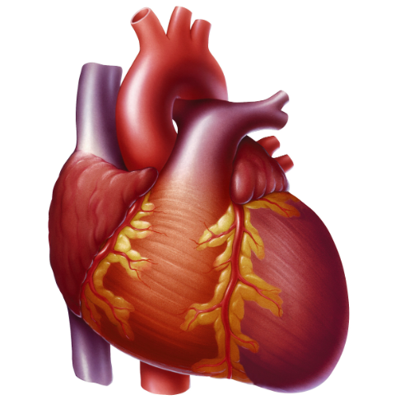
Heart Disease Clinical Data Analysis
Team 1
Daniel Allen
(Registered Nurse)
Aleksandra Kutz
(Social work)
Hardeep Gumber
(Research Scientist)
Krishan Pandey
(Infectious disease researcher)
Anvita Iyer
(Accounting)
Notes:
Hardeep

Slide 2

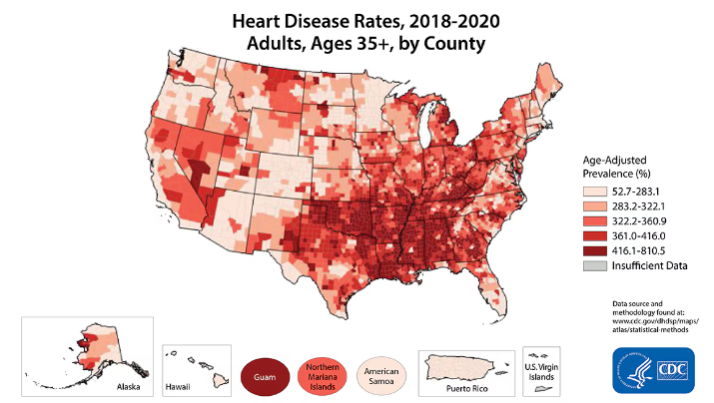
Why Analyze Heart Disease?
Leading cause of death for most racial and ethnic groups.
One person dies every 33 seconds
In 2022, 702,880 people died from heart disease.
1 in every 5 deaths.
Financial burden $252.2 billion (2019 - 2020)
.
Notes:
Hardeep

Slide 3
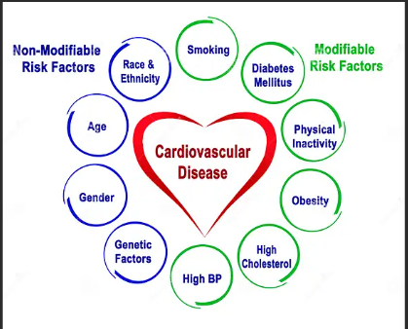
Variables Analyzed - "Inside the Heart of Our Data"
Data Source (1989): Kaggle Heart Disease Dataset (kaggle.com)
Age
Sex
Resting Blood Pressure
Cholesterol Level
Fasting Blood Sugar
Resting Blood Pressure
Maximum Heart Rate Achieved
Exercise Induced Angina
ST depression on ECG
Calcification of Major blood Vessels
Notes:
Hardeep
Update the list to remove variable not studied.

Slide 4

Purpose of the Analysis
Can we predict the presence of
heart disease
using
clinical data?
Notes:
Hardeep

Slide 5
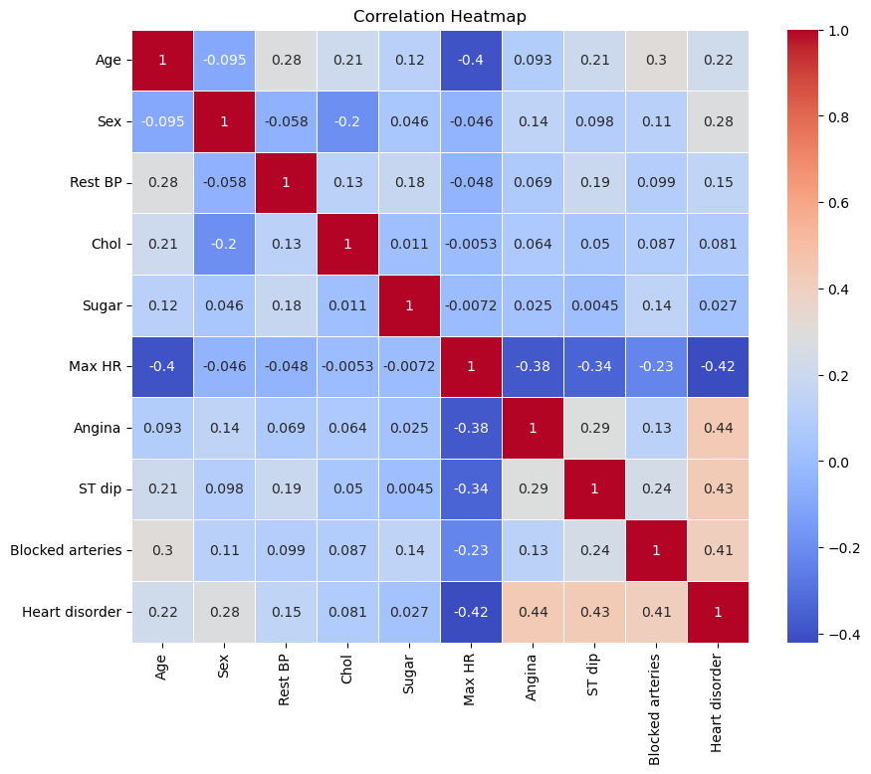

Correlations among different variables
Strong Positive correlation
Chest pain
Abnormal ST curve on ECG
Blocked arteries
Strong Negative correlation
Maximum heart rate
Other Positive correlations
Age
Sex
Resting Blood pressure
Cholesterol
Fasting blood sugar
Notes:
Hardeep
This slide presents a correlation heatmap that shows the relationships between key variables related to heart disease.
Correlation values
Positive values indicate a positive correlation (as one variable increases, so does the other).
Negative values indicate a negative correlation (as one variable increases, the other decreases).
The closer the value is to 1 or -1, the stronger the correlation.
Positive Correlations:
Chest Pain shows a strong positive correlation with the likelihood of a heart disorder. This is expected, as chest pain is a common symptom of heart disease.
An abnormal ST curve on ECG is also highly correlated with heart issues. The ST segment typically reflects heart health, and any deviations indicate heart abnormalities.
Blocked arteries (presumably indicated by angiogram results) have a strong correlation with heart disorders. Blockages are a primary factor leading to heart attacks and heart failure.
Negative Correlation
Maximum heart rate (Max HR) has a strong negative correlation with heart disorders. This implies that patients with lower maximum heart rates tend to show higher likelihoods of heart conditions, which makes sense since a lower heart rate can indicate reduced cardiovascular efficiency.
Using these correlations, we can identify key predictors of heart disease, which will help in early diagnosis and preventative strategies.

Slide 6


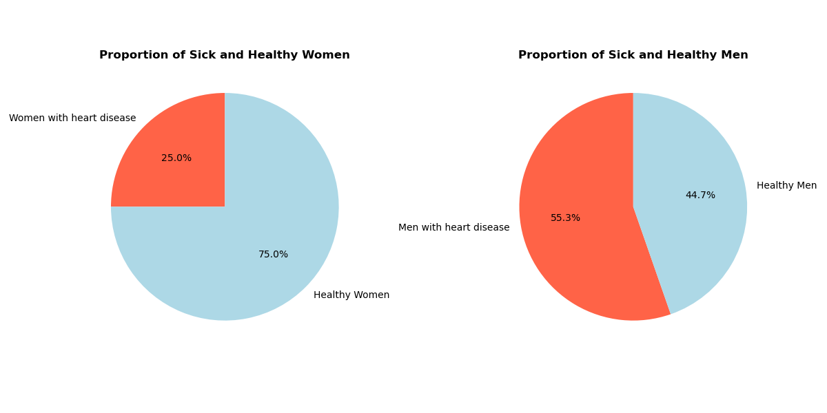
Does gender matter in heart disease?
?
There is a significant association between gender and heart disease.
Men suffer from heart disease more often.
Notes:
Aleksandra
https://stock.adobe.com/search?k=male+symbol (gender symbol)

Slide 7
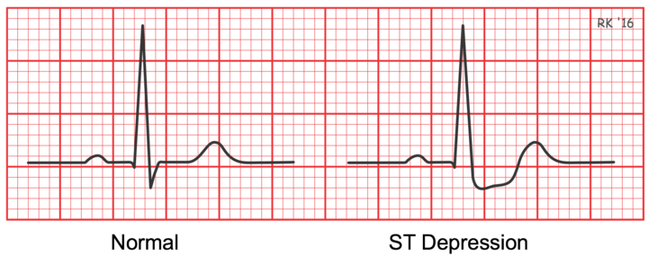
Are older patients more likely to experience exercise-induced angina and abnormal ST depression levels?
Exercise-induced angina is a type of chest pain that occurs when the heart muscle doesn't get enough oxygen while exercising.
An abnormal ST depression levels on an electrocardiogram (ECG) is when the ST segment appears below the baseline and is lower than normal. It can indicate health conditions such as hypokalemia, myocardial ischemia, or a side effect of medications.
Notes:
Aleksandra
ST segment represents the period in the cardiac cycle when the muscular layer of the heart contracts to expel blood.

Slide 8
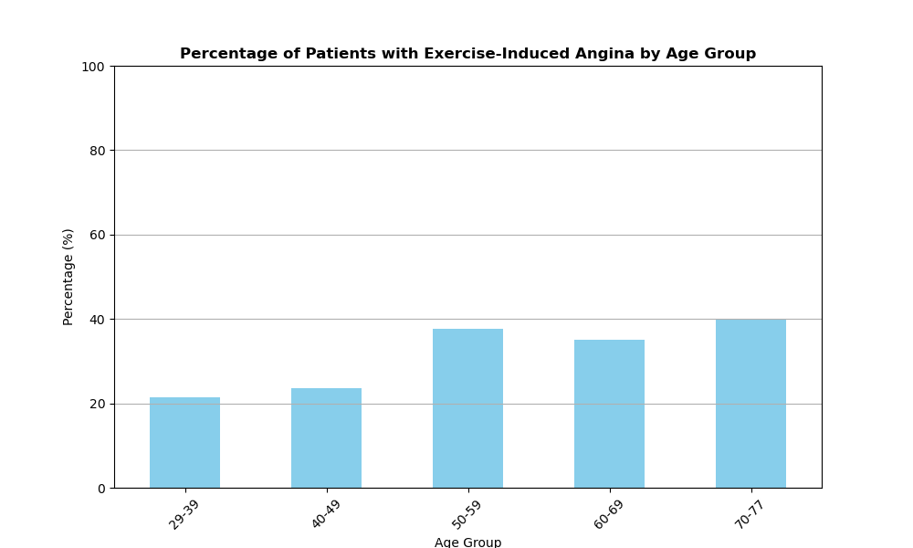
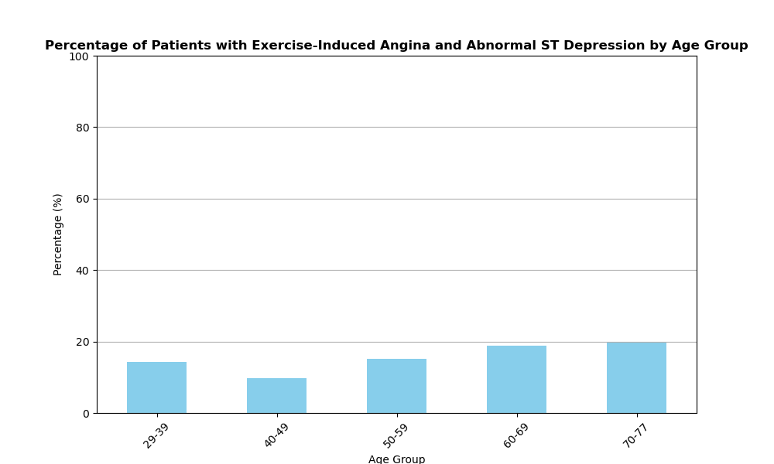
Proportions of patients with exercise induced angina across age groups.
Proportions of patients with exercise induced angina and abnormal ST depression levels across age groups.
According to the result of the chi-squared test there is no significant association between age groups and exercise-induced angina with abnormal ST depression.
Notes:
Aleksandra

Slide 9
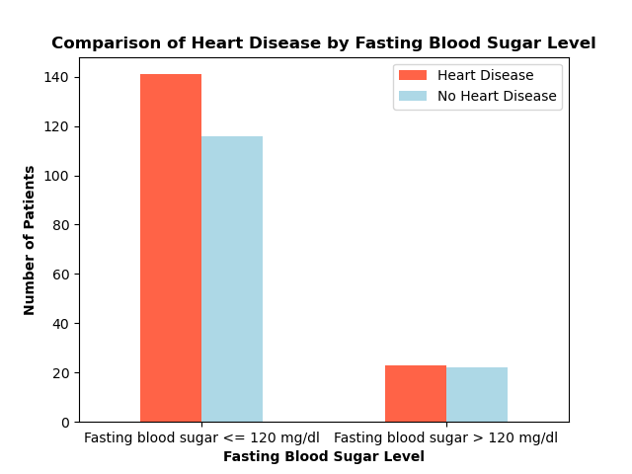
Are patients with fasting blood sugar levels greater than 120 mg/dL more likely to have heart disease?
The null hypothesis was not rejected.
But due to small frequencies in certain categories.
The data analysis indicates a potential relationship between the variables.
It would be beneficial to conduct further research to explore this relationship.
Notes:
Aleksandra

Slide 10
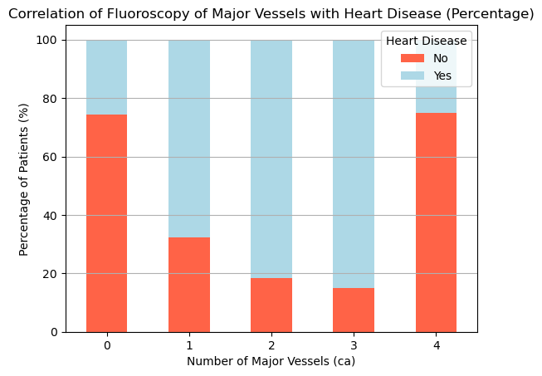
Correlation of calcification of major vessels and heart disease
Determined the correlation between degrees of calcification and heart disease; plotted percentage of individuals in each category.
Calcification of major vessels is a good indicator of heart disease !
Chi-Square Statistic: 73.68984583164412 P-Value: 3.77e-15
Reject the null hypothesis - there is a significant relationship between the number of blood vessels (ca) and heart disease.
Notes:
Krishan.
Chi-Square Statistic: 73.68984583164412 P-Value: 3.77e-15
Degrees of Freedom: 4 Expected Frequencies Table: [[95.03311258 79.96688742] [35.29801325 29.70198675] [20.63576159 17.36423841] [10.86092715 9.13907285] [ 2.17218543 1.82781457]]
Reject the null hypothesis - there is a significant relationship between the number of blood vessels (ca) and heart disease.

Slide 11
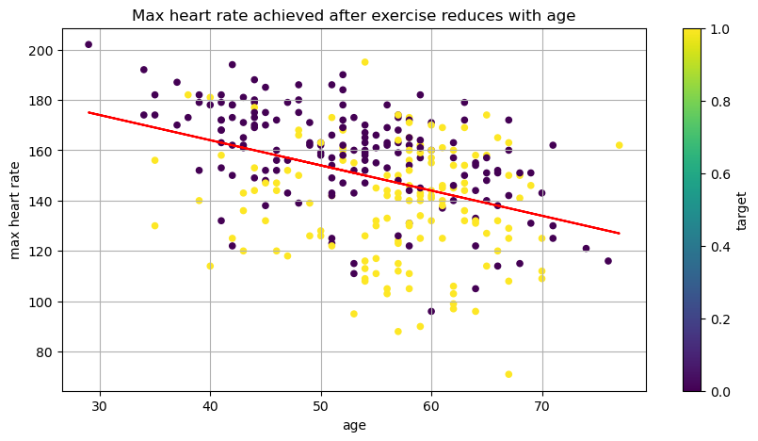
Correlation between max heart rate post exercise, age and heart disease
Negative correlation between age and max heart rate achieved.
As age increases, the ability to achieve higher maximum heart rate after exercise, reduces.
After 50 years of age, there is a sharp increase in number of heart disorder patients (yellow dots).
Diseased
Healthy
Correlation between age and max heart rate achieved: -0.3952

Slide 12
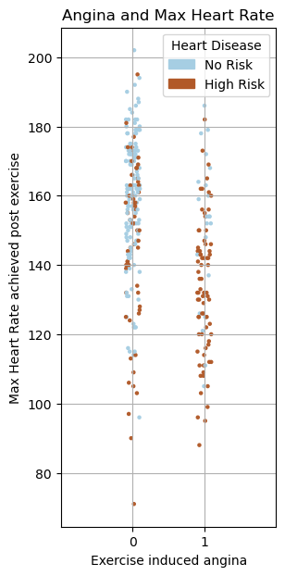
Correlation between post exercise max heart rate, chest pain (angina) and heart disease
Higher maximum heart rate is achieved in participants with no chest pain (angina=0).
Majority of patients with exercise induced chest pain (angina =1) are -
not able to achieve higher max heart rate
have higher risk for heart disease
Notes:
krishan

Slide 13
Hypothesis:
Patients with higher cholesterol, slower heart rates, Increased sclerotic arteries, and exercise-induced angina have a higher probability of developing heart disease.
To test hypothesis we created (2) logistic regression analysis maps:
1. 3D Surface Plot: Measure Heart Rate vs Cholesterol levels as indicators of heart disease
2. Heatmap: investigates the influence of exercise-induced angina and calcification of vessels indicating a higher probability of heart disease.
Notes:
Daniel

Slide 14
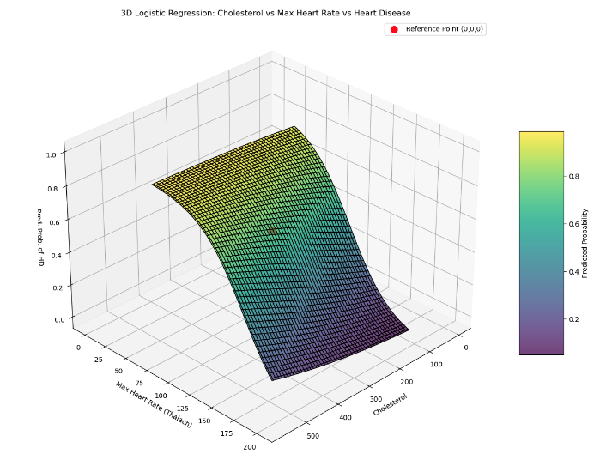
Notes:
Daneil

Slide 15
Key Insights from the 3D Surface Plot
1. Probability Gradient: The plot shows predicted heart disease probabilities based on cholesterol and max heart rate.
2. Logistic Curve: Probability increases as cholesterol rises and heart rate lowers.
3. Reference Point: The red marker highlights a baseline with minimal predicted risk.
Notes:
Daniel

Slide 16
Heatmap of Angina and Major Vessels
OBJECTIVE
We used a heatmap to display the interaction between
exercise-induced angina (exang)
number of major “hardened” vessels (ca)
…To predict the probability of chest pain which indicate heart disease
Notes:
Daniel

Slide 17
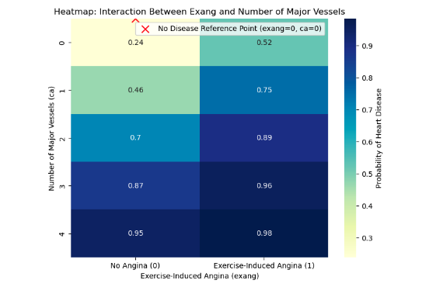
Notes:
Daneil

Slide 18
Summary of Key Findings
Probability Map: Shows heart disease risk based on angina and major vessels count.
Higher Risk: The more sclerotic the major arteries, coupled with exercise-induced angina increases the probability of heart disease.
Age: It is an important factor to which many other factors correlate, such as, maximum heart rate, resting blood pressure, blocked arteries and abnormal ECG patterns.
Notes:
Daniel
This slide presents a correlation heatmap that shows the relationships between key variables related to heart disease.
Correlation values
Positive values indicate a positive correlation (as one variable increases, so does the other).
Negative values indicate a negative correlation (as one variable increases, the other decreases).
The closer the value is to 1 or -1, the stronger the correlation.
Positive Correlations:
Chest Pain shows a strong positive correlation with the likelihood of a heart disorder. This is expected, as chest pain is a common symptom of heart disease.
An abnormal ST curve on ECG is also highly correlated with heart issues. The ST segment typically reflects heart health, and any deviations indicate heart abnormalities.
Blocked arteries (presumably indicated by angiogram results) have a strong correlation with heart disorders. Blockages are a primary factor leading to heart attacks and heart failure.
Negative Correlation
Maximum heart rate (Max HR) has a strong negative correlation with heart disorders. This implies that patients with lower maximum heart rates tend to show higher likelihoods of heart conditions, which makes sense since a lower heart rate can indicate reduced cardiovascular efficiency.
Using these correlations, we can identify key predictors of heart disease, which will help in early diagnosis and preventative strategies.

Slide 19
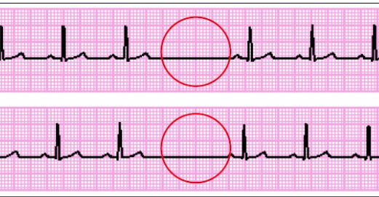
The Missing Beat: Dataset Limitations
Small dataset
Reduced sample size after data clean-up. Small sample sizes can limit the reliability and generalizability of findings.
Imbalanced dataset
Sex: Fewer women participants than men
Age: Data set does not include participants older than 77 years
Fasting blood sugar: Fewer people with levels >120 mg/dl
Our analysis does not necessarily reflect the interdependencies between all variables that collectively increase the likelihood of heart disease.
There are many predictors of heart disease not considered in our analysis, such as lifestyle,diet, race, genetics, etc.
Notes:
Anvita
This slide focuses on the limitations of our dataset, which can impact the reliability and comprehensiveness of our heart disease analysis.
Small Dataset size- Our initial dataset included 1,025, after removing duplicates, our sample size was significantly reduced to 302 rows. This smaller sample size might not fully capture the broader trends present in larger, more diverse populations, thereby limiting the usefulness of our results.
Age limitations - The dataset does not include participants over 77 years old, which omits a critical population segment since heart disease risk increases with age.
Gender Imbalance - Our dataset was disproportionate to men; total number of women was 96 as compared to 206 men participants
Fasting Blood Sugar Levels: There are fewer people with high fasting blood sugar levels (>120 mg/dl), which is important because high blood sugar is a key risk factor for heart disease, especially in diabetic patients.
Lack of Interdependencies:
The analysis does not fully reflect the complex interplay between variables. Heart disease is not caused by any single factor but by multiple interrelated factors (e.g., age, cholesterol, blood pressure).
Our dataset might miss some of these interdependencies due to its size and scope, potentially leading to oversimplified conclusions.

Slide 20
"Our goal isn’t just to understand heart disease—
it’s to beat it."
Notes:
Anvita

Slide 21
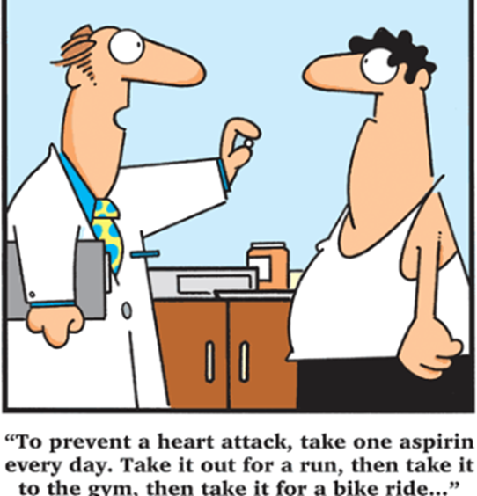

Reminders for maintaining a healthy heart
Eat healthy
Get enough Sleep
Get regular health check ups
Maintain healthy weight
Maintain an active lifestyle
Laugh a little
Notes:
Anvita
Early Signs of Heart Disease: Harvard’s Prevention Tips | The Epoch Times

Slide 22

Watch out for symptoms:
Persistent fatigue
Shortness of breath after mild activity
Swollen feet or legs
Abnormal heartbeat
Chest pains
Notes:
Anvita
Early Signs of Heart Disease: Harvard’s Prevention Tips | The Epoch Times

Slide 23


